Slide 1

R and Python
Let’s sharpen our tools

Slide 2
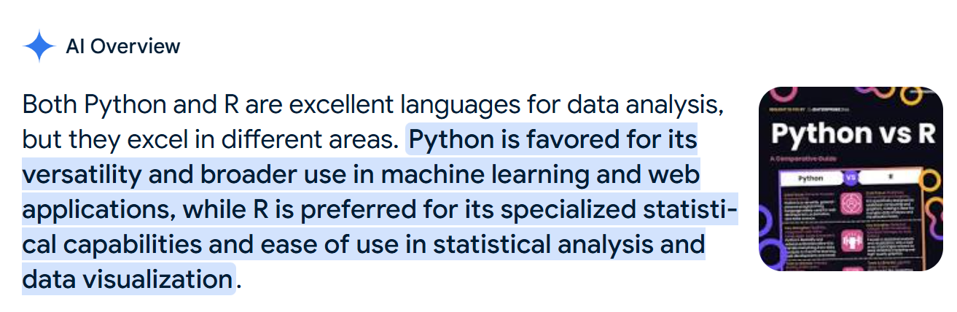
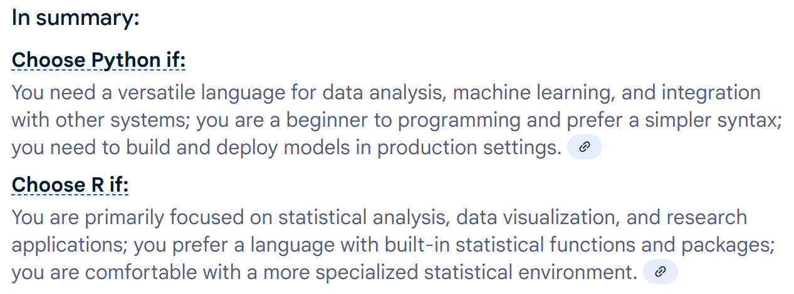


Slide 3
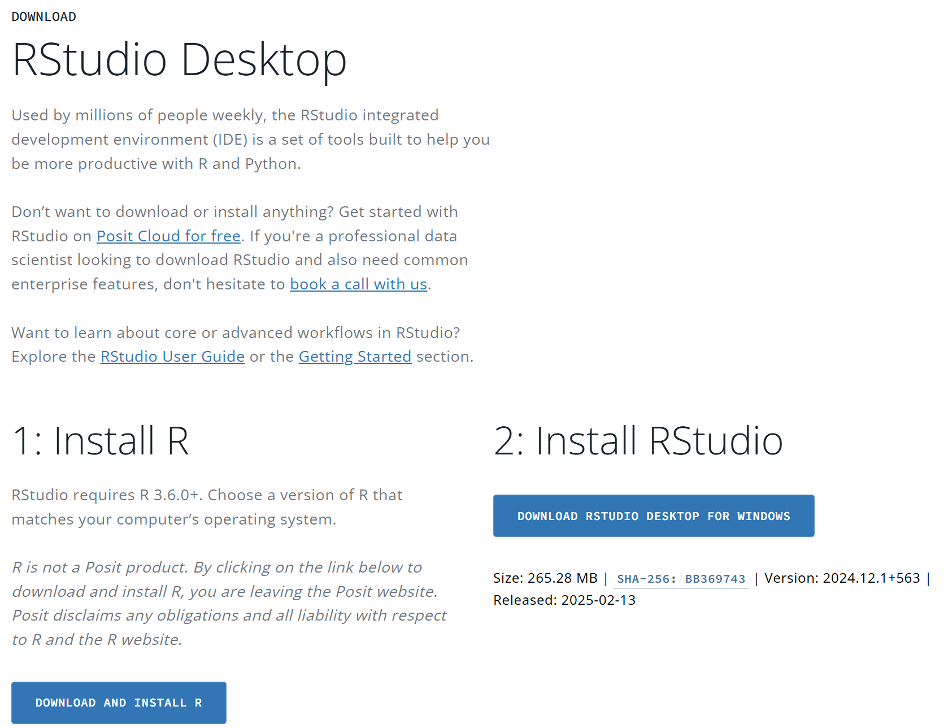
Installing R
Go to https://posit.co/download/rstudio-desktop/

Slide 4
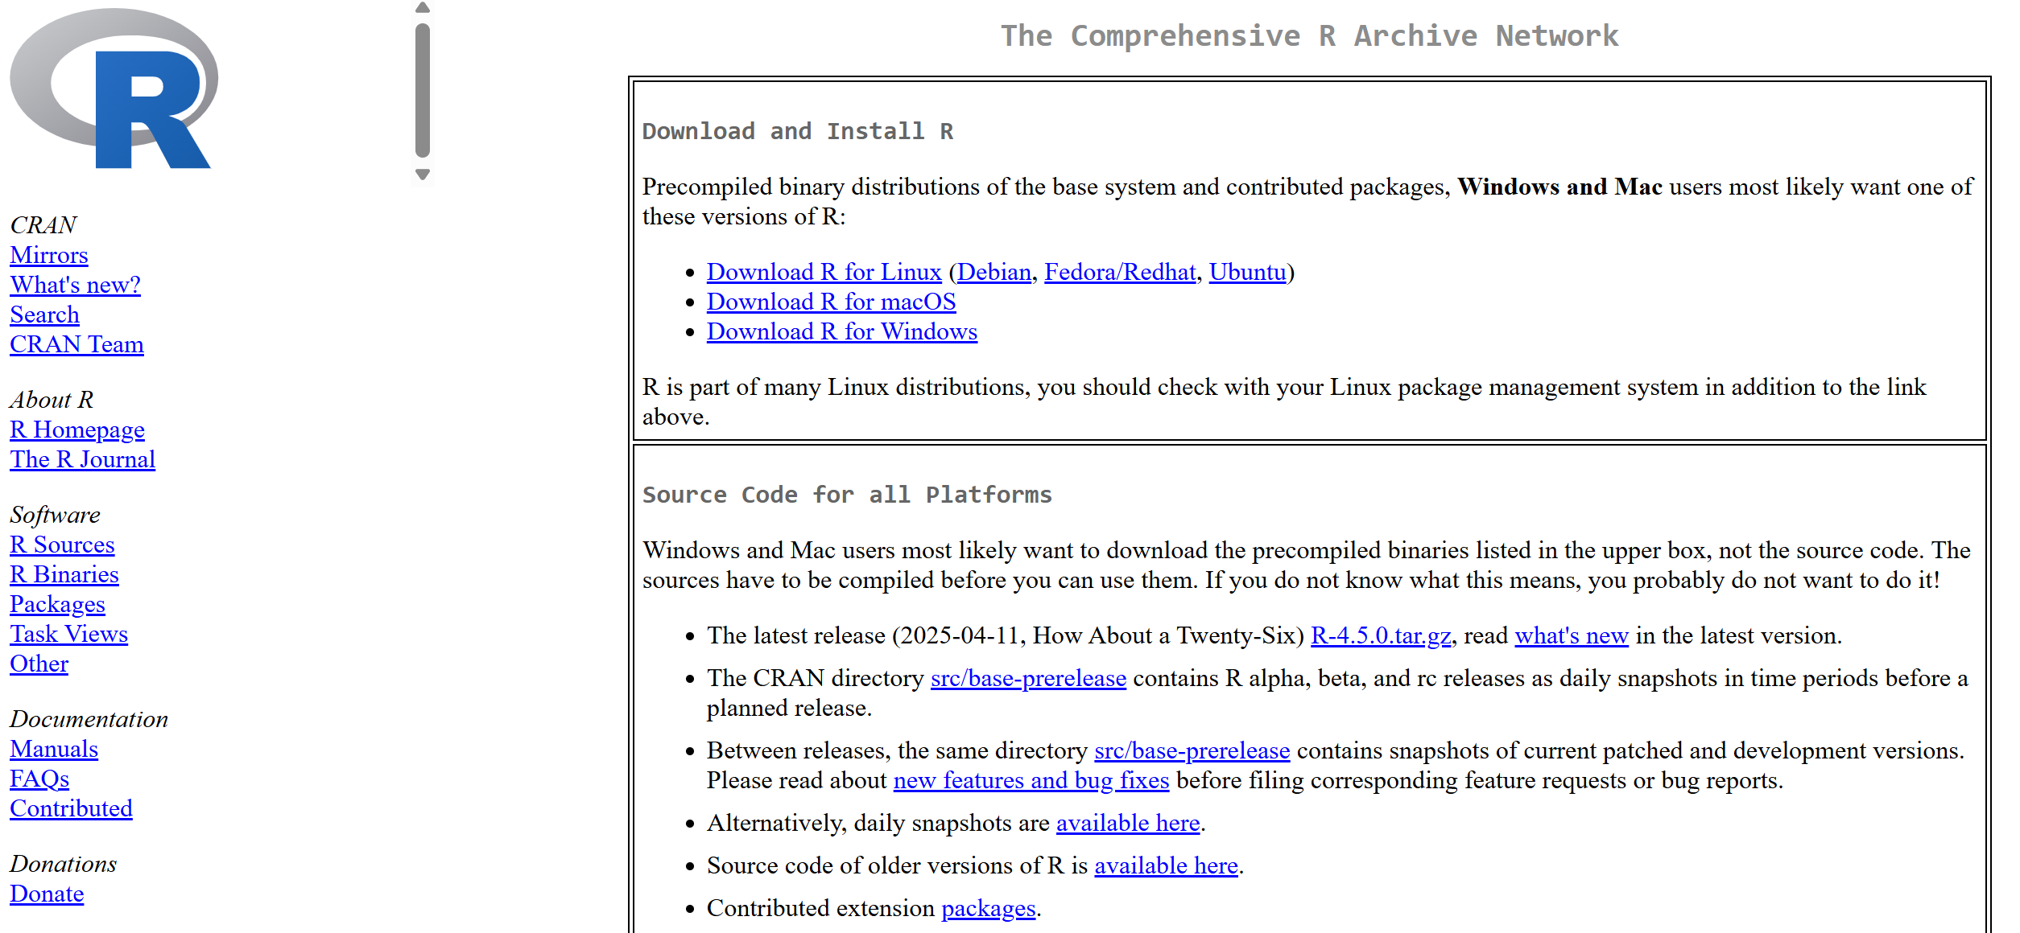
Step 1: Install R

Slide 5
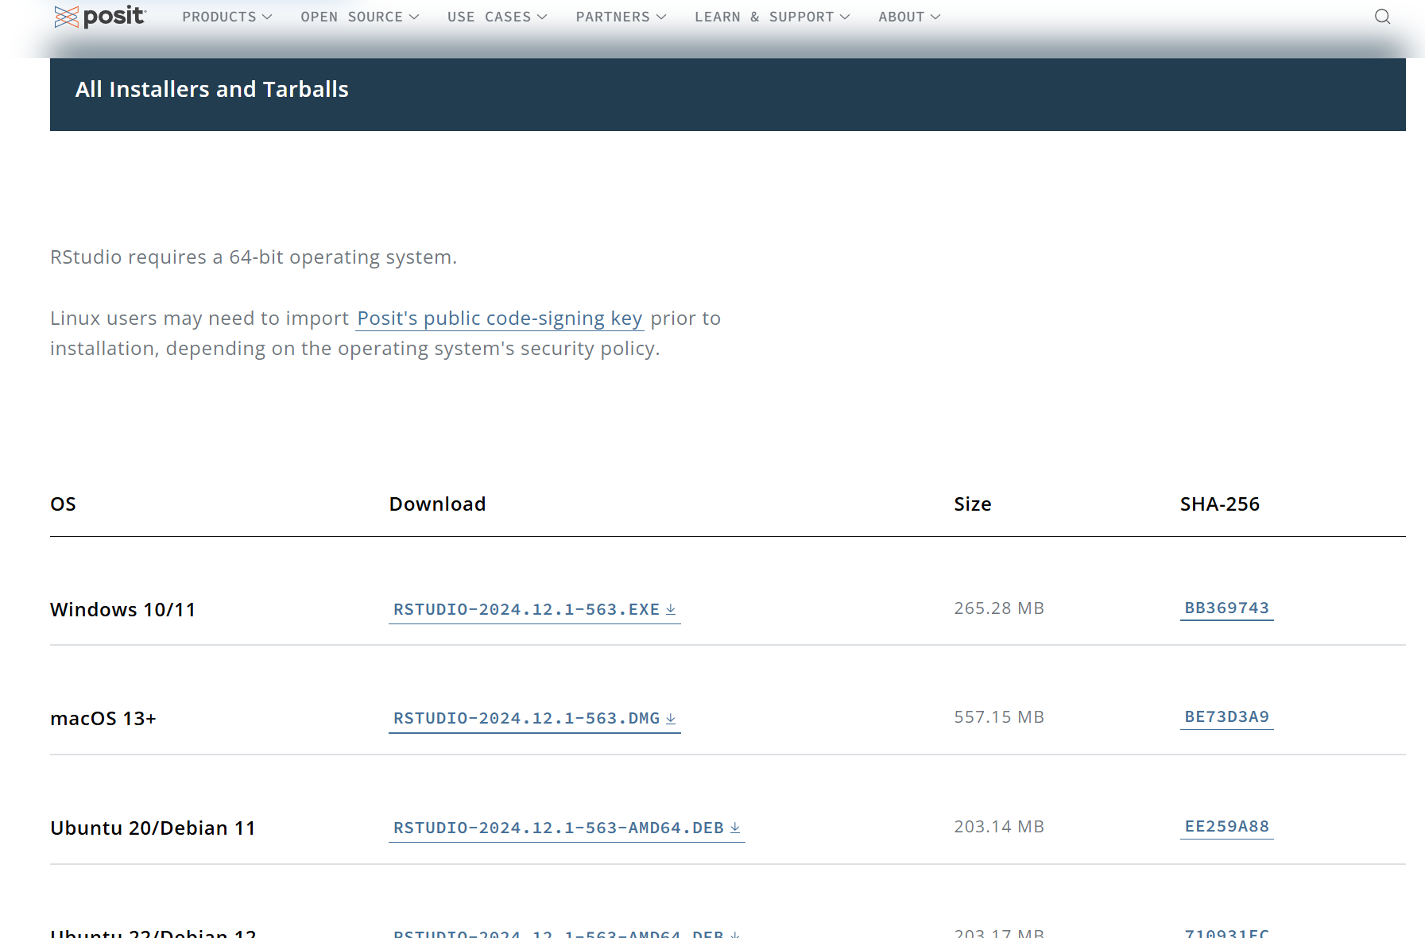
Step 2: Install RStudio

Slide 6
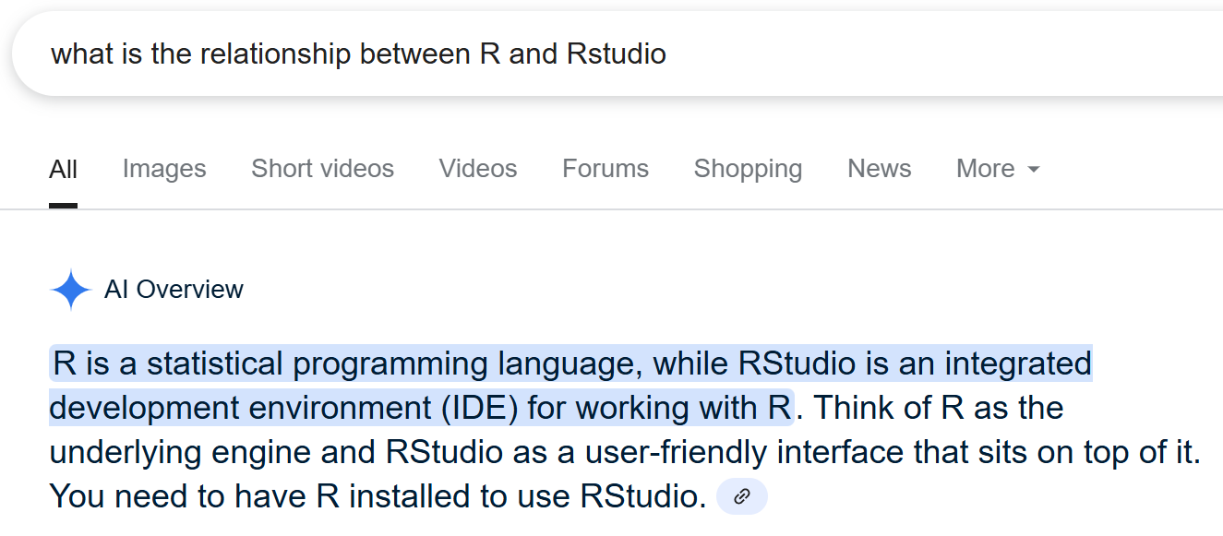
R and RStudio

Slide 7

An Alternative Access: BYU Cloud Apps

Slide 8

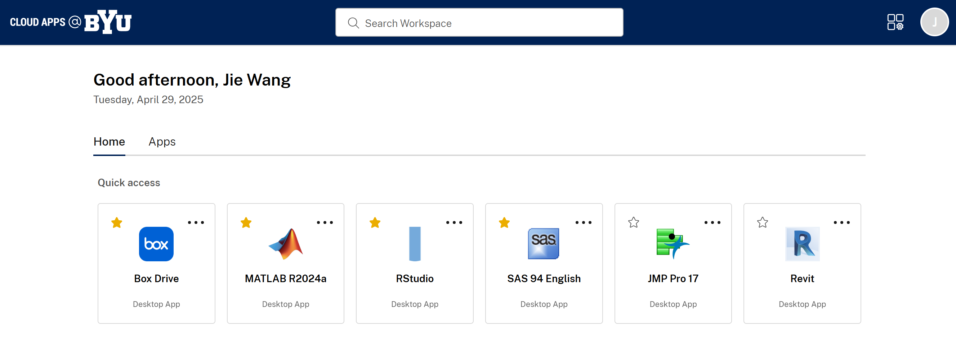
BYU Cloud Apps

Slide 9
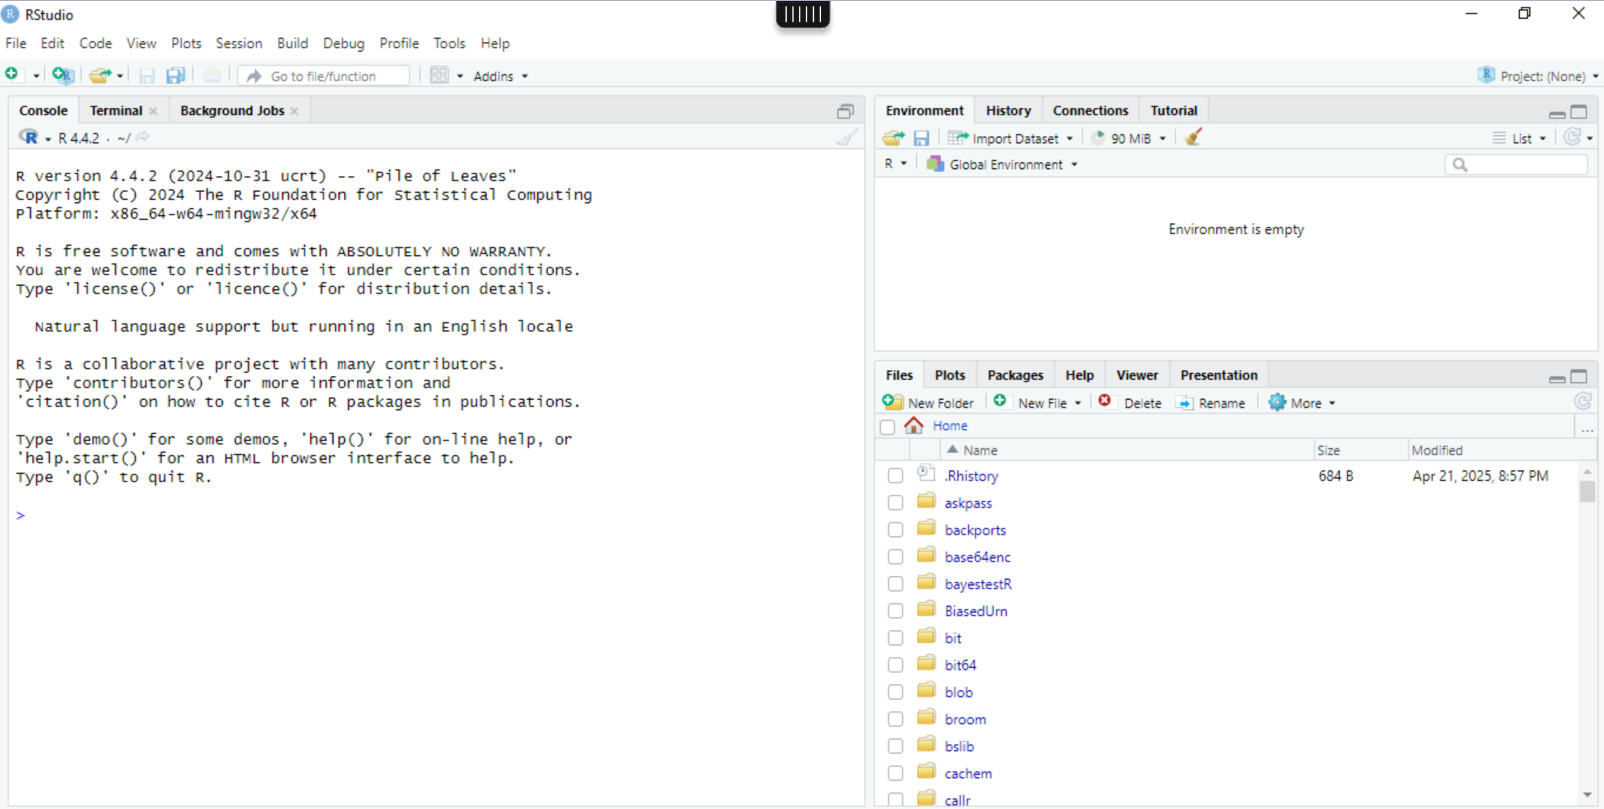
RStudio Interface

Slide 10
Get Start
Try this
https://education.rstudio.com/learn/beginner/

Slide 11
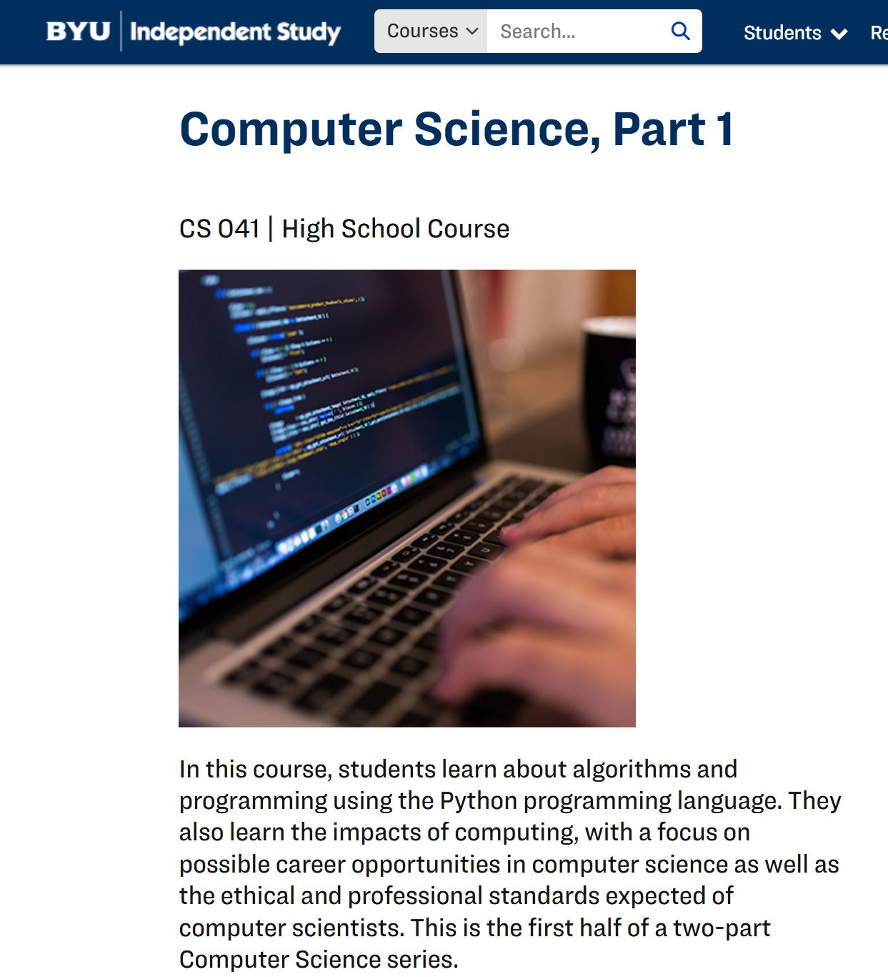
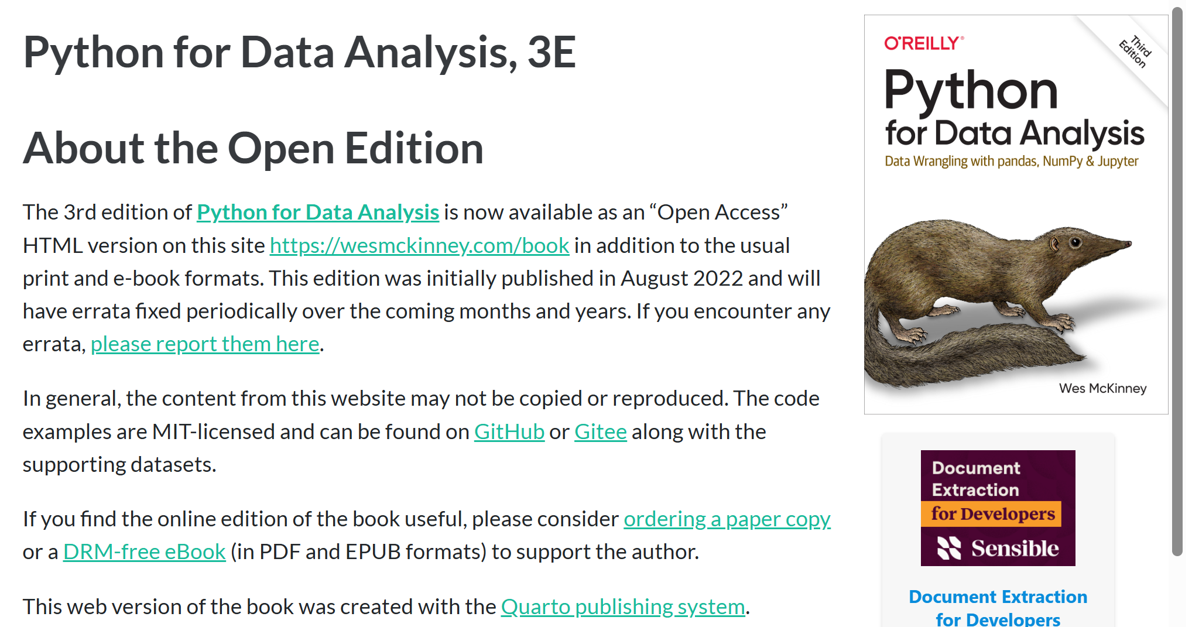
Python

Slide 12
We will provide sample codes in both languages.

